Slide 1

Building tomorrow’s capabilities today
Mark L Goodwin
Deputy Director/COO
Virginia Tech
Hume Center for National Security and Technology

Slide 2
Building tomorrow’s capabilities today
Mark L Goodwin
Deputy Director/COO, Hume Center

Slide 3
Topics for discussion
Developing the Next Generation of Enduring Talent
Roadmap/Methodology to Transition Science to Solutions
Example success combining #1 and #2 and what it could mean for Islamic Counter-terrorism Coalition (ICC) vision

Slide 4
Mission and Organization
Educating the next generation of national security leaders

Slide 5



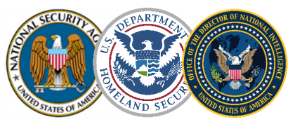
Hume Center – Snapshot
President
National Capital Region
10 faculty/staff
5 affiliated professors
15 graduate students
Sponsor Profile
VP Research & Innovation
Provost
DOD S&T
DARPA, ONR, etc
Institute for Critical Technology and Applied Science
College of Engineering
IC S&T
IARPA, etc
Hume Center
Outreach/Education
Philanthropy, IRAD, NSF
Outreach and Education
Information
Systems
Electronic
Systems
Aerospace
Systems
Blacksburg Campus
30 faculty/staff
15 affiliated professors
35 graduate students
150 undergraduates
Operations and Program Support
NSA/DHS Center for Academic Excellence
IC Center for Academic Excellence
CyberCorps Scholarship for Service Site

Slide 6
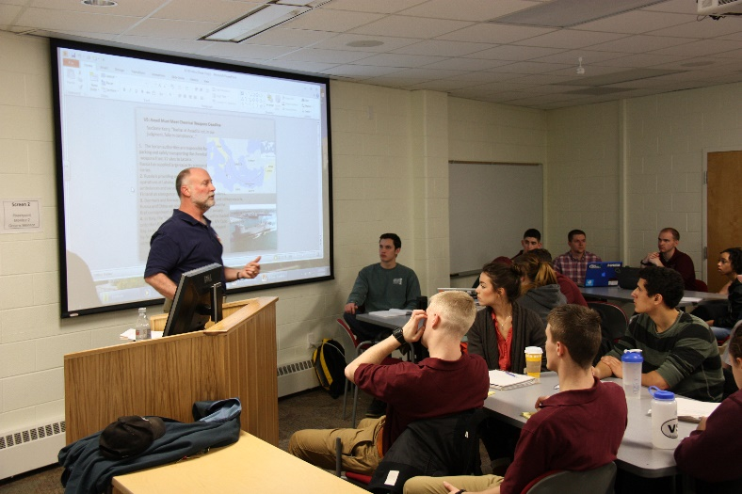
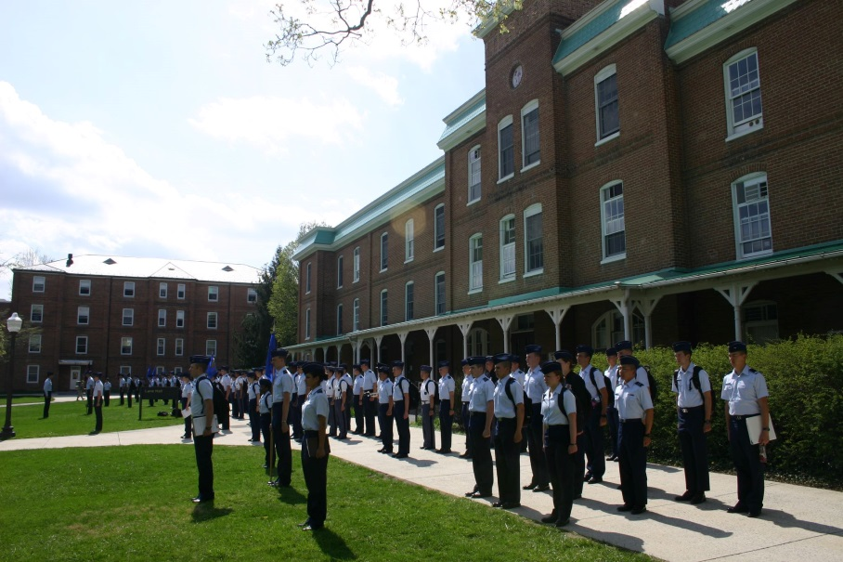
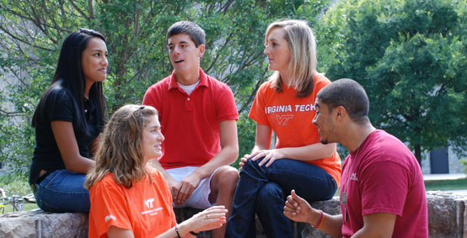
Outreach and Education
Tailored Education
Partner Engagement
Scope
  200 students engaged annually
  50 students graduating annually, most with security clearances
  $3M/yr in scholarships, fellowships, and assistantships
SAIC National Security Education Program
  Minor in national security
  Hume Endowment scholarships
  Student events, seminars
  Internship and job placement for defense/intel industry and agency
  Annual projects and colloquium
Cybersecurity
  Minor in cybersecurity
  Cybercorps Scholarship for Service
  Hewlett cyber policy program
Student programs supported via industry sponsorship
Academic Affiliates Program (AAP)
  Recruiting-focused program
  Varying membership levels with different benefits
Security and Software Engineering Research Center (S2ERC)
  NSF Industry/University Cooperative Research Center
  Membership dues directly support graduate student research
  Access to intellectual property via the consortium
Customized programs with mixture of education and research

Slide 7

Advanced Research
Technology Areas
Mission Areas
Electronic Systems Information Systems Aerospace Systems | Cyber-EW Convergence Anti-Access Area Denial Contested/Congested Operations Cyber-Physical System Security Critical Infrastructure Safety-Critical Platforms Internet of Things Mission Orchestration Cognitive Tasking Activity Inference/Forecasting Applied Deep Learning
Assured
Communications
Electronic
Warfare
Radar
Embedded
Security
Cognitive
Computing
Unmanned
Systems
Small
Satellites
We do not accept contract research that doesn’t allow student participation

Slide 8
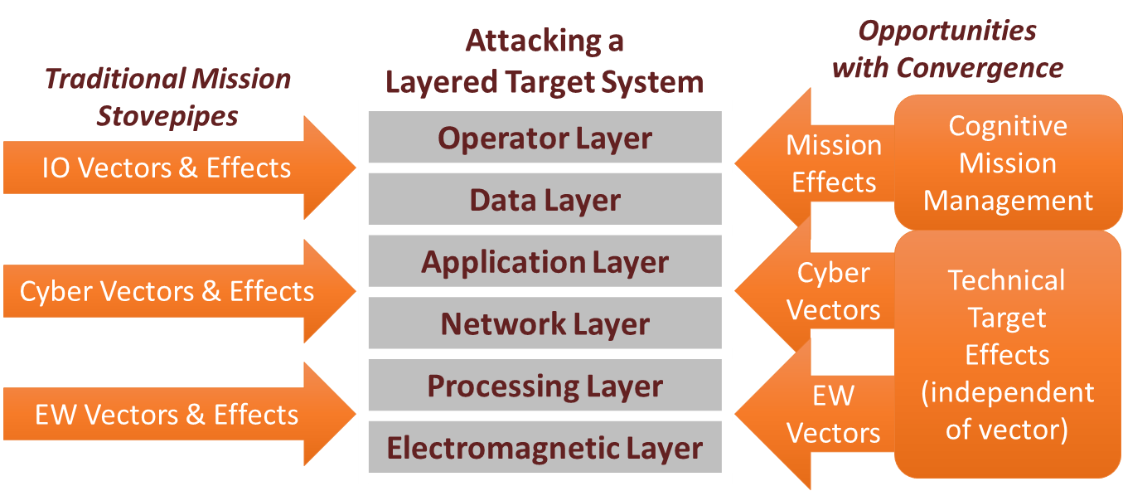
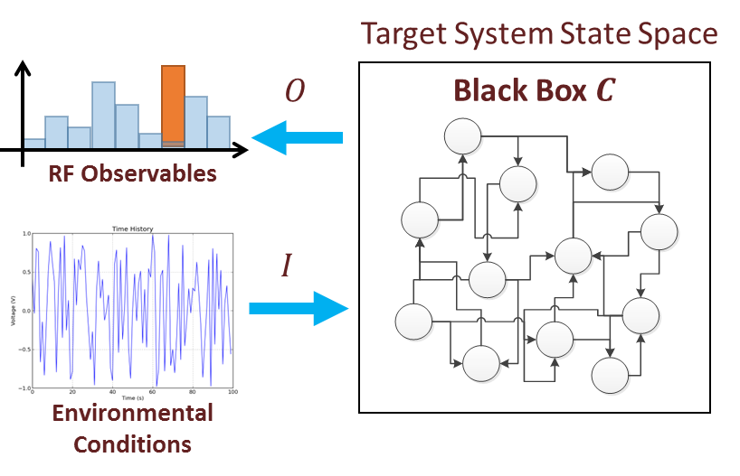
Cyber/Electronic Warfare Convergence
Adversary models focus on estimating state machine and current state of adversaries in order to anticipate their reaction to your stimulus
Researching new effects possible with convergence
Develop mission concepts for application of cyber/EW techniques
DOD/IC Programs
Counter UAV C2 Cognitive EW Counter-Radar Nets Network EW Cognitive EW Limits

Slide 9
Entrepreneurship and Innovation
Engaging industry and government to provide research, education and career opportunities for students

Slide 10

Innovation and Entrepreneurship
Strong track record of technology transition
  Transition research and development to major programs of record
  Transition dual-use technologies to venture-backed startup companies
Strategic relationships with venture community
Three spin-off companies
  Optio Labs – mobile security
  Federated Wireless – spectrum sharing and 5G
  HawkEye 360 – RF mapping and geolocation via small satellites
1 | 2 | 3 | 4 | 5 | 6 | 7 | 8 | 9
Technology Hype Curve
(Garner)
Valley of Death
Technology Readiness Level (TRL)
Hume Center spin-off companies have raised $45M in venture capital and employ 75 people in Boston MA, Baltimore MD, Arlington VA, Nashville TN, and San Jose CA

Slide 11
Innovation and Entrepreneurship at VT
Undergraduate student level - Pamplin College of Business
  Apex Systems Center for Innovation and Entrepreneurship (endowed)
  Entrepreneurship – New Venture Growth Minor
    MGT 3064: Cornerstones of Entrepreneurship and Innovation 3
    MGT 4064: Developing Entrepreneurial Ventures (Pre:3064)
  DC I-Corps
  Innovate Living Learning Community
  VT KnowledgeWorks – Open workshops and business plan competitions
Graduate student level – Engineering departments
  Hume Center Technology Venture program
    Modeled after Stanford University MS&E 273
    Fundable business plans – real venture spinouts
    Deliberate process for value creation

Slide 12
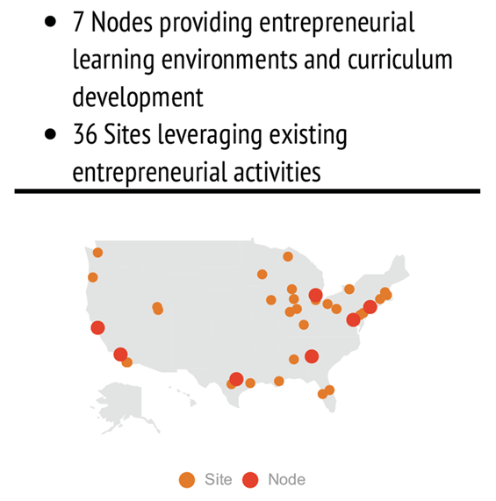

National Science Foundation DC I-Corps
Commercialization of technology that has been supported previously by government (NSF) funded research
Three distinct components of I-Corps:
  I-Corps Teams are composed of the principal investigator(s) (PI), an entrepreneurial lead (EL), and a mentor.
  The I-Corps Nodes serve as hubs for education, infrastructure and research that engage academic scientists and engineers in innovation; they also deliver the I-Corps Curriculum to I-Corps Teams.
  The I-Corps Sites are academic institutions that catalyze the engagement of multiple, local teams in technology transition and strengthen local innovation.

Slide 13
NSF DC I-Corp International Program
Tailored programs
Benefits
Based on the needs, expectations, and cultural differences of the host countries.
  Faculty exchanges – reciprocal train the trainers
  Student exchanges
  Internships
International examples of “DC I-Corps”:
  Successfully created a mirror in Mexico
  Starting the process in Chile
  Other cooperative programs with Korea, Netherlands, Japan, Brazil
  In negotiations with Egypt, and others in Middle East
Job creation – working in teams
Value creation - understand how and why and to whom
Diversification of economy - find a great market for product or service that you had not previously considered
Gain appreciation for what it takes to commercialize technology and the barriers to adoption
Expand network exponentially, as you’ll have priceless contact with teachers, investors, customers, and mentors

Slide 14
Implementation and impact
Using HawkEye 360 as an example

Slide 15
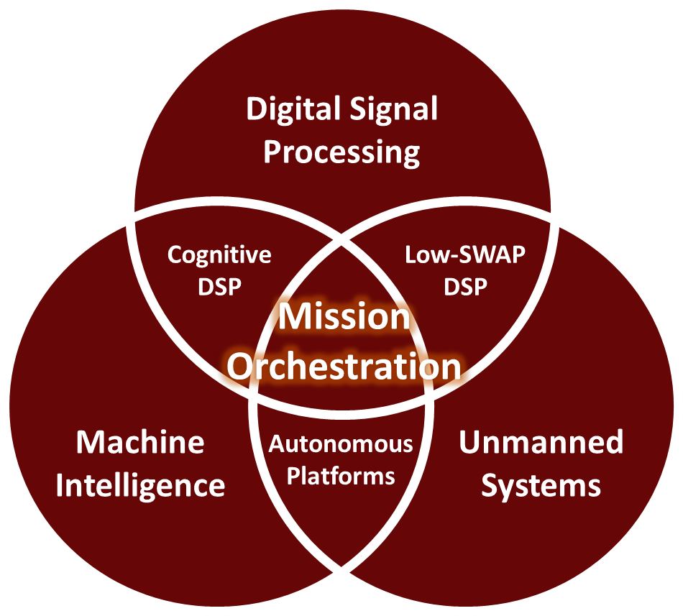
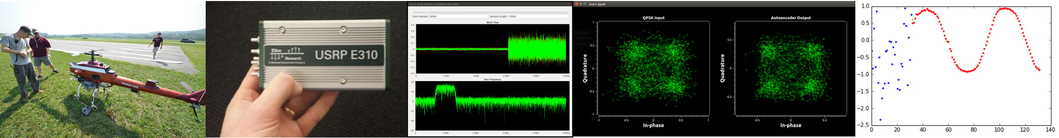
Mission Orchestration
Sits at the intersection of payloads, platforms, and machine intelligence
  Activity based intelligence develops a priori data on mission targets
  Deep learning performs sophisticated pattern recognition and data processing
  Probabilistic Graph Models infer relationships between observables and target behavior
  Optimization engines manage payload and platform schedules based on learned policies
Significant additional efficiency from intelligence systems
Access to data relevant to your mission, and partners who can deliver results

Slide 16
Final remarks
Virginia Tech motivated to become:
  21st century global land-grant university on the foundation of Ut Prosim, “that I may serve”
  Global destination and exchange for talent: students, faculty, staff and partners
  Renown for addressing toughest global challenges by transitioning science to solutions
Universities need to partner with other universities, industry and government organizations
Talent + Technology = Innovation
  If an immediate partner
  “Technology transfer is always done best on two feet”
Collaborators must seek to align incentives to success
Working together we can address global challenges, including ICC

Slide 17
Thank you !

Slide 18
